Slide 1





Stacked Data Matrices Why should one do this?
Hermann Schmitt
Universities of Manchester and Mannheim

Slide 2
Purpose of Stacking Data Matrices
Augmenting the level of generality
In two-party systems like the US, predicting “generic” party choice is straightforward: What explains the support of Democrats also predicts that of Republicans (perhaps with a reversed sign of the regression coefficient).
This is not so simple in multi-party systems with often many more than two choice options.
In those environments, if one wants to establish the factors determining party choice as such – as opposed to the choice of the CDU, the Greens, the SPD and so on – one needs to stack the original rectangular data matrix – with respondents defining the rows and variables defining the columns – as many times as there are relevant parties.

Slide 3
Consequences of Stacking Data Matrices
Number of cases
This multiplies the number of observations from say 1000 respondents to 5000 respondent-party dyads (if the party system is made up by five relevant parties). In order to avoid that this adversely affects the findings (e.g. due to possible autocorrelation), care must be taken to calculate appropriate statistical measures (e.g. clustered standard errors).
Generic variables
The most important consequence however is that in the stacked data matrix one can compute generic variables like social background, partisanship, issue or ideological distances, candidate evaluations and the vote (see the figure in the next slide).

Slide 4
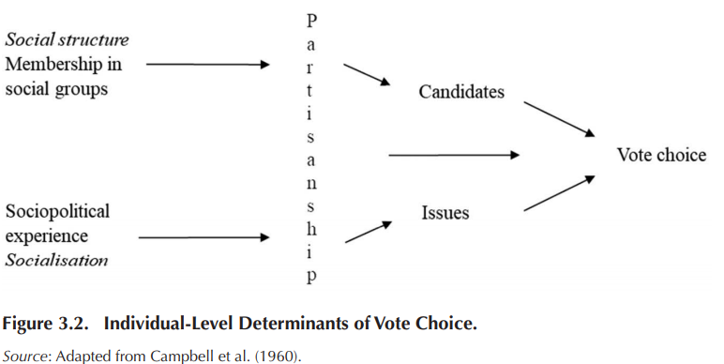
Example: A Basic Model of Vote Choice

Slide 5
Tricky Questions in SDM Analyses
What is a relevant party? Possible answers: All parties participating in an election are relevant. All parties in parliament are relevant. All parties with a potential to build, or block the formation of, a national government (Sartori 1976) are relevant. All parties for which we have ptv’s and left-right placements etc. are relevant ☺
Are relevant parties equally important? Possible answers: All parties are equally important (as they are co-equal choice options). The importance of parties, and hence the weight of their “stack”, varies according to their electoral strength.

Slide 6
Continuous or Discrete Vote Choice as Dependent Variable?
Continuous Vote Choice.
Two possible operationalisations: ptv’s or ppp’s. Ptv’s are measures of the propensity to vote, obtained by directly asking respondents how likely it is that they would ever vote for each of the relevant parties (van der Eijk and Franklin 1996). Ptv’s are a standard component of EES voter surveys Ppp’s are indirect measures of the propensity to vote, obtained by pairwise comparisons of respondents general evaluations (e.g. on like-dislike scales) of relevant parties (Schmitt 2009). Like-dislike scales are a standard component of CSES surveys.
Analyses can be done in the OLS regression framework.
Discrete Vote Choice.
Operationalised by the recall of vote choice. Analyses can be done in the logistic regression framework. Alternative is conditional logistic regression.

Slide 7
Contextual Properties and SDM Analyses
One Election One Country Study (i.e. a standard national election study). SDM Analyses least prominent here.
Contextual properties of a political party can be added to its party stack. Example: the European integration position of that party as derived from expert surveys.
One Election Many Countries Case (the EES standard).
Contextual properties of political parties can be added to the relevant party stack, and country properties can be added to all party stacks of that country. Example: the European integration position of parties, and the duration of EU membership.
Many Elections Many Countries (the TEV database, or the CSES studies).
Contextual properties of political parties can be added to the relevant party stack, and country properties can be added to all party stacks of that country, and this for each election separately. Example: the European integration position of parties, and the duration of EU membership, at the time of each election covered.
Notes:
Sub-national contexts

Slide 8
How this all can be done …
… will be explained in much more detail by Giuseppe and later on by Federico.
Thank you.

